Slide 1

DESIGN & SIMULATION OF A
4-BIT UNIVERSAL
SHIFT REGISTER
Q0
Q1
Q2
Q3
DIGITAL LOGIC DESIGN
ANNADANAM SAHASRA • 262008088 • AI & DS
KOTHAKONDA ADITHYA • 2620090079 • CSIT
KUNDAVARAM ASWITHREDDY • 2620090003 • CSIT
SPOORTHY KAMMARI • 2620090035 • CSIT
VELETI NAGA MANASWINI • 2620090039 • CSIT
GUIDE • KARTHEEK V.
KLH UNIVERSITY | ACADEMIC YEAR 2026

Slide 2

2. Introduction
2. Introduction
A shift register is a sequential digital circuit used to store and transfer binary data.
A 4-bit Universal Shift Register (USR) can hold, shift left, shift right, and parallel-load 4-bit data.
It combines multiple data-transfer operations in one compact circuit.
Applications include data storage, serial/parallel conversion, communication systems, and digital processors.
Simulation allows the design to be verified before hardware implementation.
2

Slide 3

3. Problem Statement
3. Problem Statement
Conventional shift registers generally support only limited data-transfer operations.
Separate circuits may be needed when multiple operations are required.
This can increase circuit complexity, hardware requirements, and design cost.
A flexible register is needed to support several operations using simple control signals.
The project designs and simulates a 4-bit Universal Shift Register to solve this limitation.
3

Slide 4


4. Objectives
4. Objectives
Design a 4-bit Universal Shift Register.
Implement four modes: Hold, Shift Right, Shift Left, and Parallel Load.
Understand the role of D flip-flops, multiplexers, clock, and control signals.
Build the circuit using digital logic components.
Simulate and verify the circuit outputs.
Validate the design using a mode-selection table and representative test cases.
4

Slide 5

5. Literature Survey / Existing System
5. Literature Survey / Existing System
SISO: Serial-In Serial-Out — serial data enters and leaves serially.
SIPO: Serial-In Parallel-Out — converts serial data into parallel form.
PISO: Parallel-In Serial-Out — converts parallel data into serial form.
PIPO: Parallel-In Parallel-Out — loads and transfers data in parallel.
Limitation: conventional registers usually focus on one specific mode.
Universal Shift Register: combines multiple operations into one flexible design.
5

Slide 6

6. Proposed System
6. Proposed System
The proposed design uses four D flip-flops with multiplexing logic and two mode-select inputs.
S1 S0 = 00 → Hold: retain the existing data.
S1 S0 = 01 → Shift Right: move data one position toward Q0.
S1 S0 = 10 → Shift Left: move data one position toward Q3.
S1 S0 = 11 → Parallel Load: load P3 P2 P1 P0 simultaneously.
Key benefits: compact design, bidirectional shifting, parallel loading, and simple control.
6

Slide 7

7. System Architecture / Block Diagram
CONTROL
S1, S0
MODE SELECTION
MULTIPLEXERS
4 × D FLIP-FLOPS
REGISTER
OUTPUTS
Q3 Q2 Q1 Q0
Parallel Inputs: P3, P2, P1, P0
Serial Inputs: SR and SL
Common Clock: CLK
7

Slide 8

8. Methodology / Implementation
8. Methodology / Implementation
Step 1: Create four storage stages using D flip-flops.
Step 2: Connect multiplexers before each flip-flop to select the required input.
Step 3: Apply S1 and S0 to select the operating mode.
Step 4: Connect serial inputs for left and right shifting and parallel inputs for loading.
Step 5: Apply a common clock to all flip-flops.
Step 6: Observe the register outputs after each active clock edge.
8

Slide 9
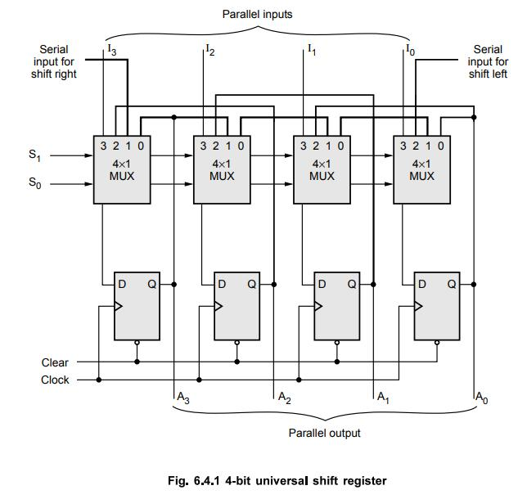
4-Bit Universal Shift Register – Circuit Diagram

Slide 10

9. Results and Discussion
S1 S0
OPERATION
EXPECTED RESULT
00
Hold
Previous data retained
01
Shift Right
Bits move toward Q0
10
Shift Left
Bits move toward Q3
11
Parallel Load
P3 P2 P1 P0 loaded

Slide 11

10. CONCLUSION
A 4-bit Universal Shift Register was successfully designed and simulated.
The design supports hold, shift right, shift left, and parallel-load operations.
The project demonstrates the practical application of sequential logic and digital circuit design.
The objectives were fulfilled by verifying the expected behavior of all four modes.

Slide 12

THANK YOU

